Slide 1


Functions
Nazrin Dolkhanova Sultanli
Programming and Computer Applications – 1

Slide 2



Agenda
Introduction
Functions: return type
Function: non return type
main() vs main(void)
Static variable
Random number generator
Recursion
Variables: Local & Global

Slide 3
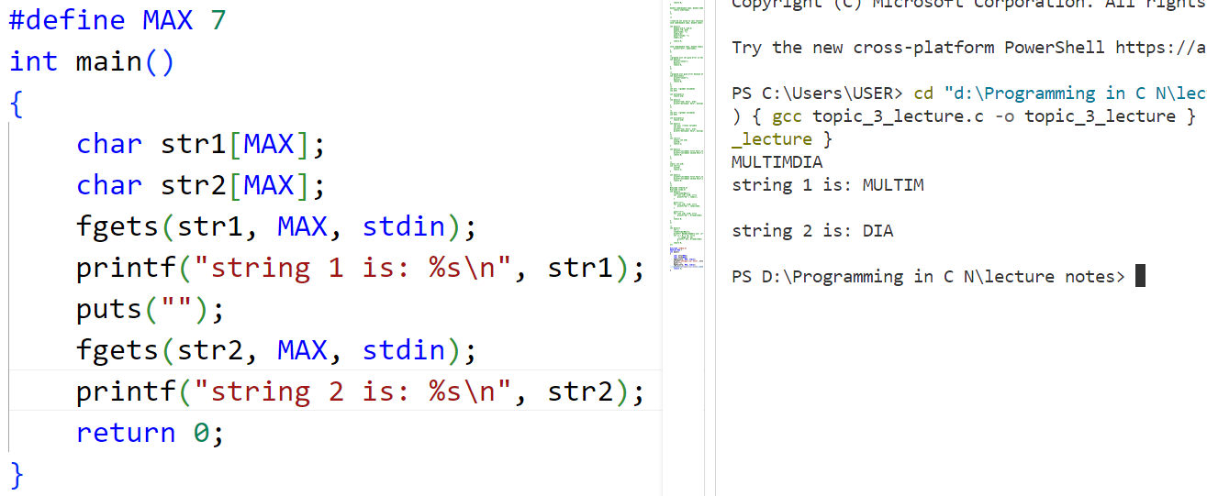
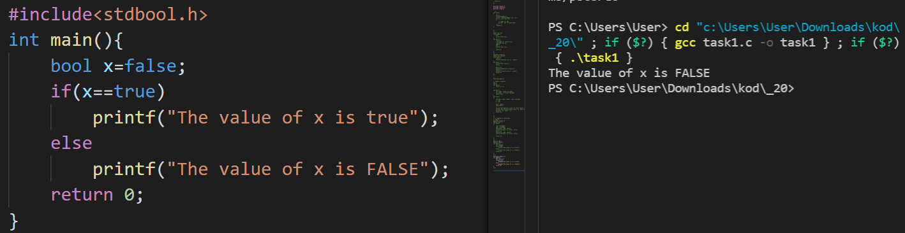
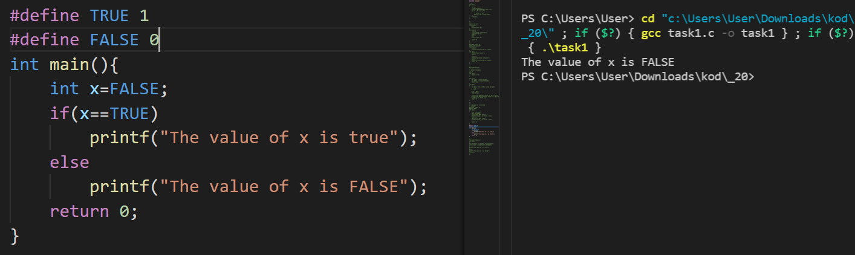
Introduction
The C library function char *fgets(char *str, int n, FILE *stream) reads a line from the specified stream and stores it into the string pointed to by str. It stops when either (n-1) characters are read, the newline character is read, or the end-of-file is reached, whichever comes first.
char *fgets(char *str, int n, FILE *stream)
str − This is the pointer to an array of chars where the string read is stored.
n − This is the maximum number of characters to be read (including the final null-character). Usually, the length of the array passed as str is used.
stream − This is the pointer to a FILE object that identifies the stream where characters are read from.
In C, Boolean is a data type that contains two types of values, i.e., 0 and 1. Basically, the bool type value represents two types of behavior, either true or false. Here, '0' represents false value, while '1' represents true value.
In C Boolean, '0' is stored as 0, and another integer is stored as 1. In C, stdbool.h header file should be used. If not use the header file, then the program will not compile.
bool variable_name;
Notes:
/*
// C program to illustrate
// fgets()
#include <stdio.h>
#define MAX 7
int main()
{
char str1[MAX];
char str2[MAX];
fgets(str1, MAX, stdin);
printf("string 1 is: %s\n", str1);
puts("");
fgets(str2, MAX, stdin);
printf("string 1 is: %s\n", str2);
return 0;
}
*/
/*
#define TRUE 1
#define FALSE 0
int main(){
int x=FALSE;
if(x==TRUE)
printf("The value of x is true");
else
printf("The value of x is FALSE");
return 0;
}
*/
///*
#include<stdbool.h>
int main(){
bool x=false;
if(x==true)
printf("The value of x is true");
else
printf("The value of x is FALSE");
return 0;
}
//*/

Slide 4

Topic three
Functions

Slide 5
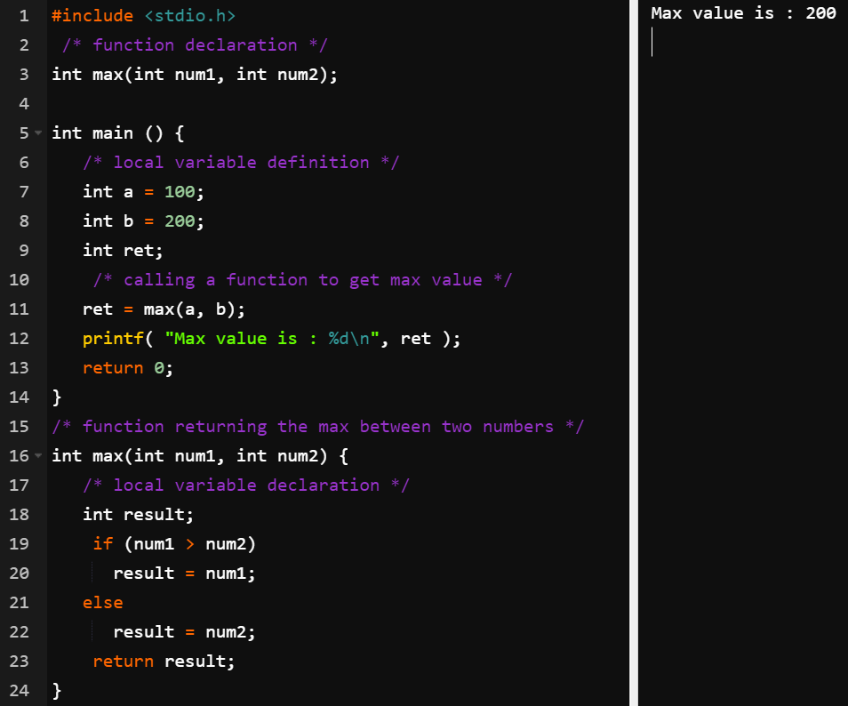
3.1 Functions: return type
return_type function_name( parameter list ) { body of the function }
A function definition in C programming consists of a function header and a function body. Here are all the parts of a function −
Return Type − A function may return a value. The return_type is the data type of the value the function returns. Some functions perform the desired operations without returning a value. In this case, the return_type is the keyword void.
Function Name − This is the actual name of the function. The function name and the parameter list together constitute the function signature.
Parameters − A parameter is like a placeholder. When a function is invoked, you pass a value to the parameter. This value is referred to as actual parameter or argument. The parameter list refers to the type, order, and number of the parameters of a function. Parameters are optional; that is, a function may contain no parameters.
Function Body − The function body contains a collection of statements that define what the function does.

Slide 6
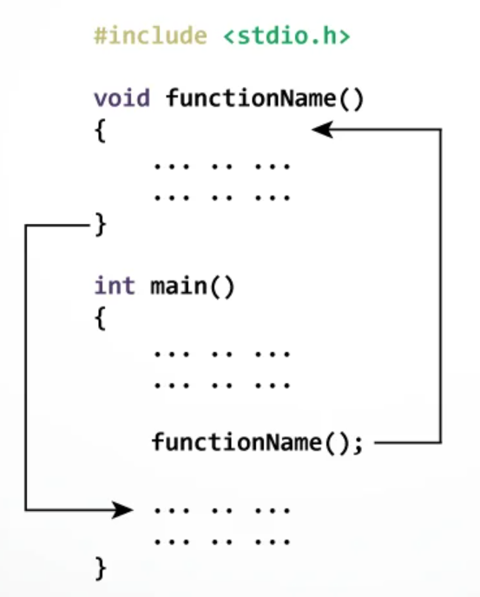
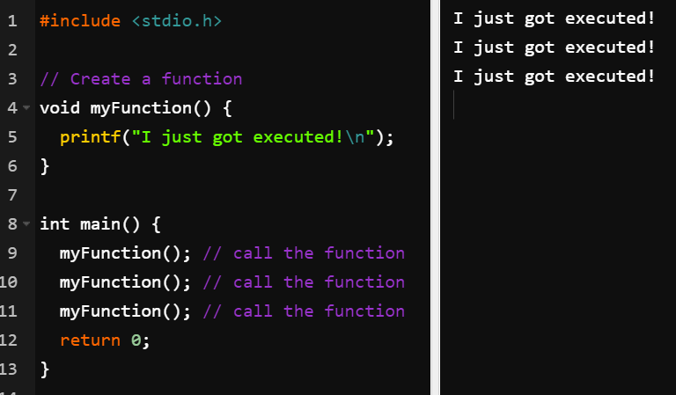
3.2 Function: non return type
Functions may be return type functions and non-return type functions. The non-return type functions do not return any value to the calling function; the type of such functions is void. These functions may or may not have any argument to act upon.

Slide 7
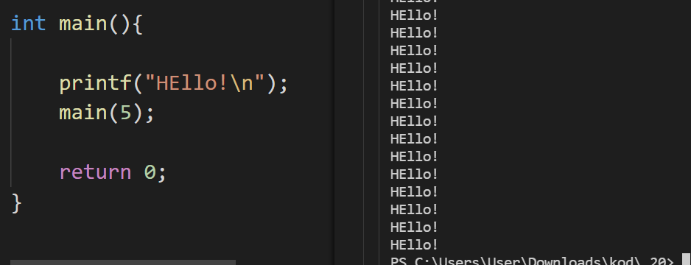
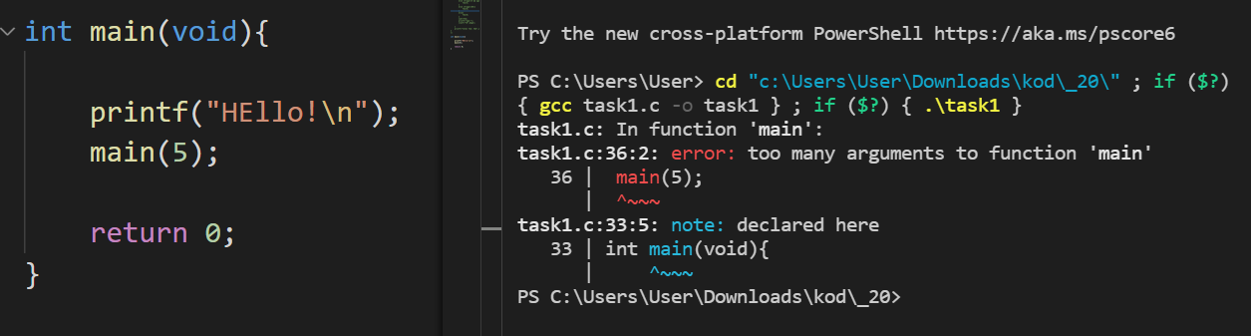
3.3 main() vs main(void)
if you write your own call to main, then () will permit you to pass it any parameters you like, while (void) will force you to pass it none.

Slide 8
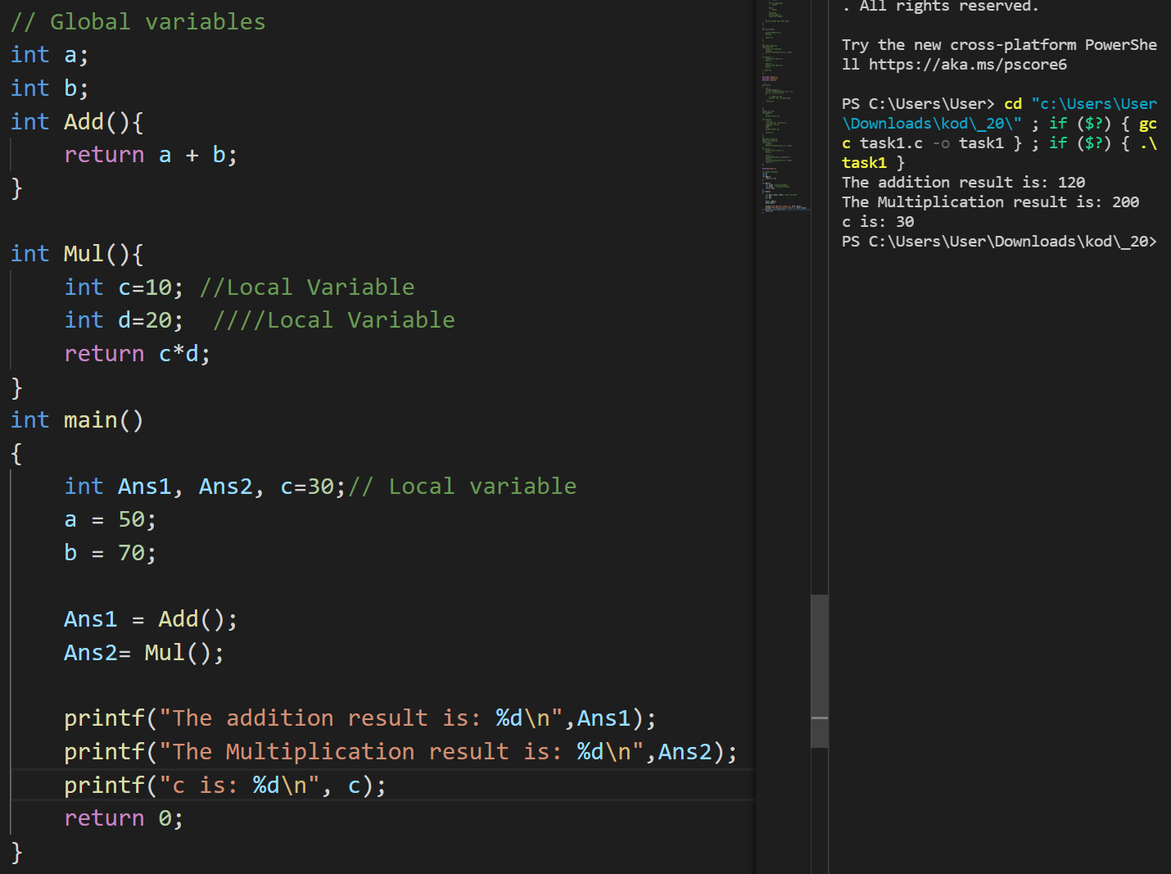
3.4 Variables: Local & Global
Variables are classified into Global variables and Local variables based on their scope. The main difference between Global and local variables is that global variables can be accessed globally in the entire program, whereas local variables can be accessed only within the function or block in which they are defined.
Notes:
// Global variables
int a;
int b;
int Add(){
return a + b;
}
int Mul(){
int c=10; //Local Variable
int d=20; ////Local Variable
return c*d;
}
int main()
{
int Ans1, Ans2, c=30;// Local variable
a = 50;
b = 70;
Ans1 = Add();
Ans2= Mul();
printf("The addition result is: %d\n",Ans1);
printf("The Multiplication result is: %d\n",Ans2);
printf("c is: %d\n", c);
return 0;
}

Slide 9
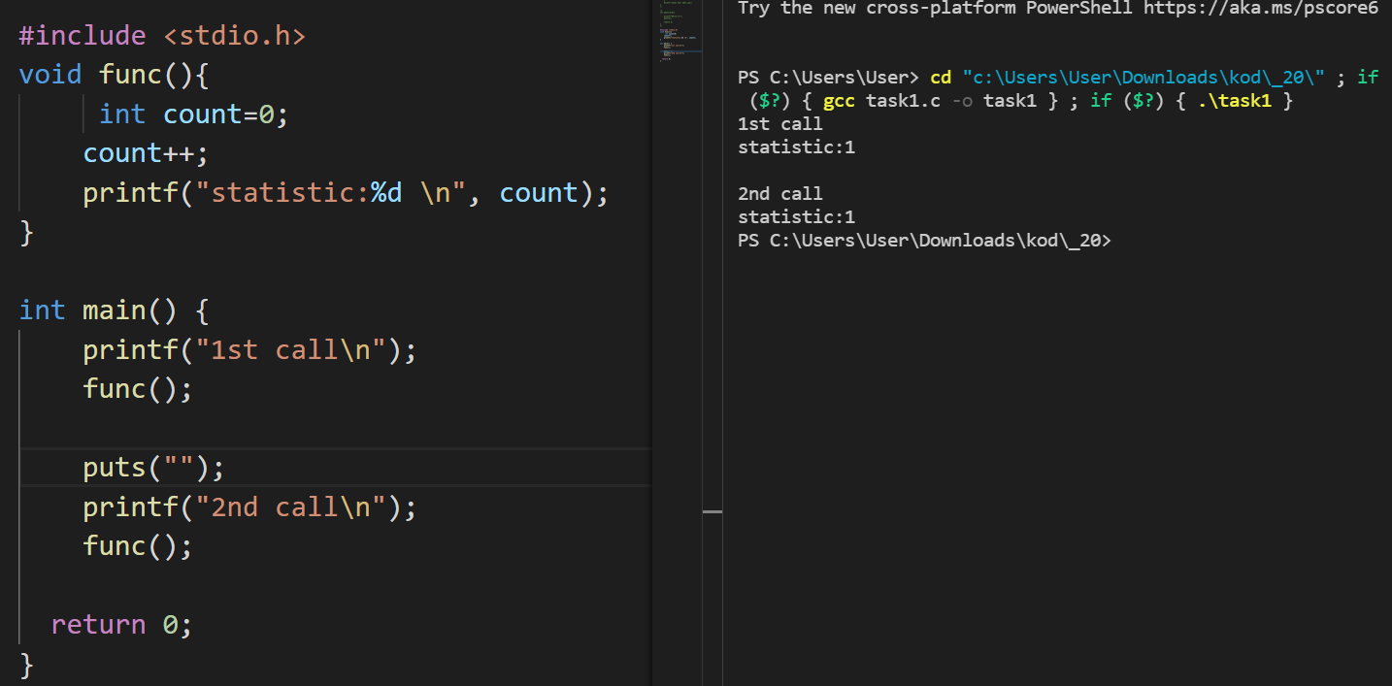
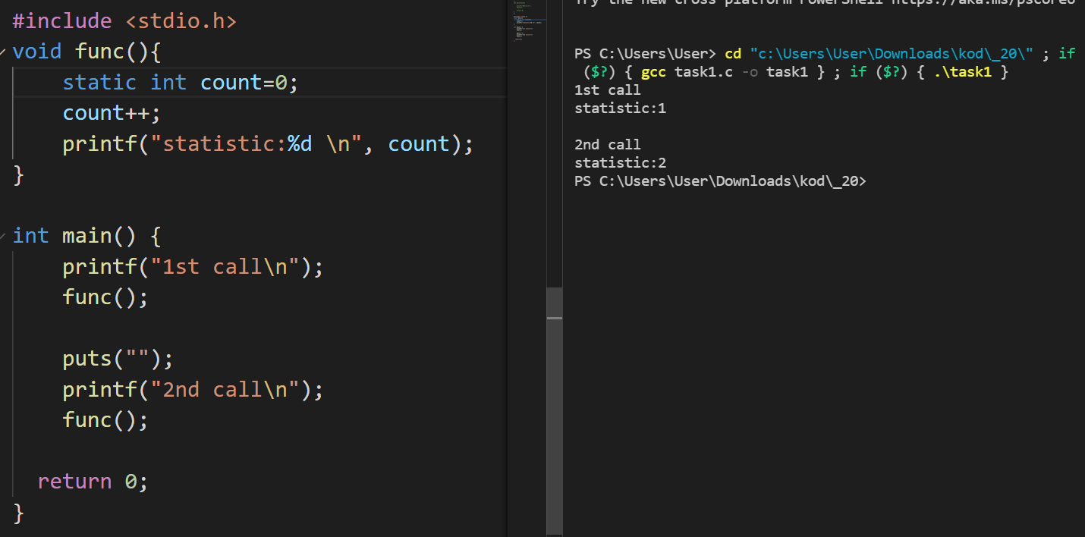
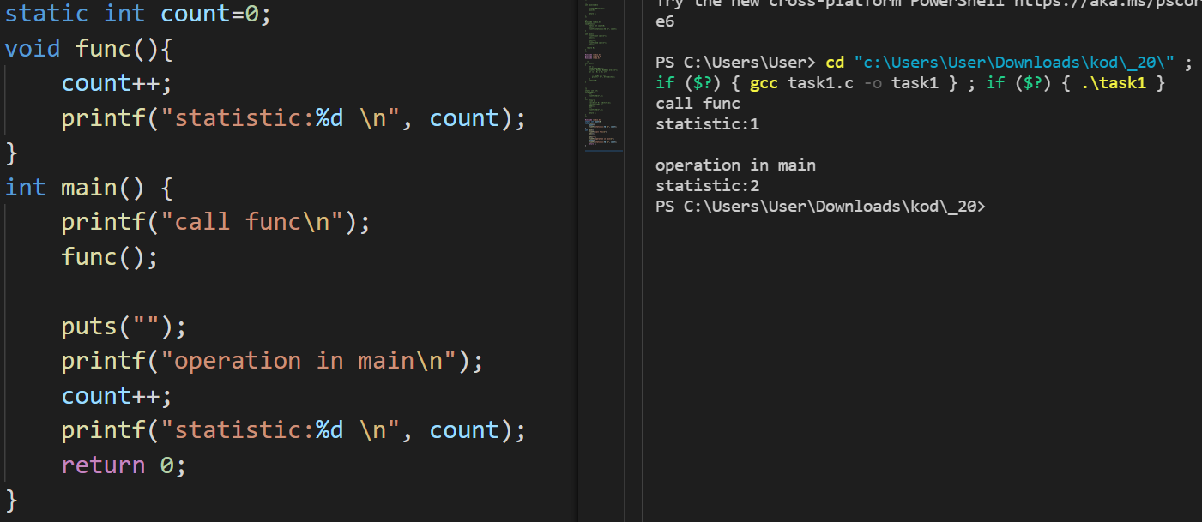
3.5 Static Variables
Static variables have a property of preserving their value even after they are out of their scope! Hence, static variables preserve their previous value in their previous scope and are not initialized again in the new scope.
Notes:
/*
static int b=7;
void addd(){
b++;
printf("%d\n",b);
}
int main(){
addd();
b++;
printf("%d\n",b);
return 0;
}
*/
/*
#include <stdio.h>
static int count=0;
void func(){
count++;
printf("statistic:%d \n", count);
}
int main() {
printf("call func\n");
func();
puts("");
printf("operation in main\n");
count++;
printf("statistic:%d \n", count);
return 0;
}
*/

Slide 10
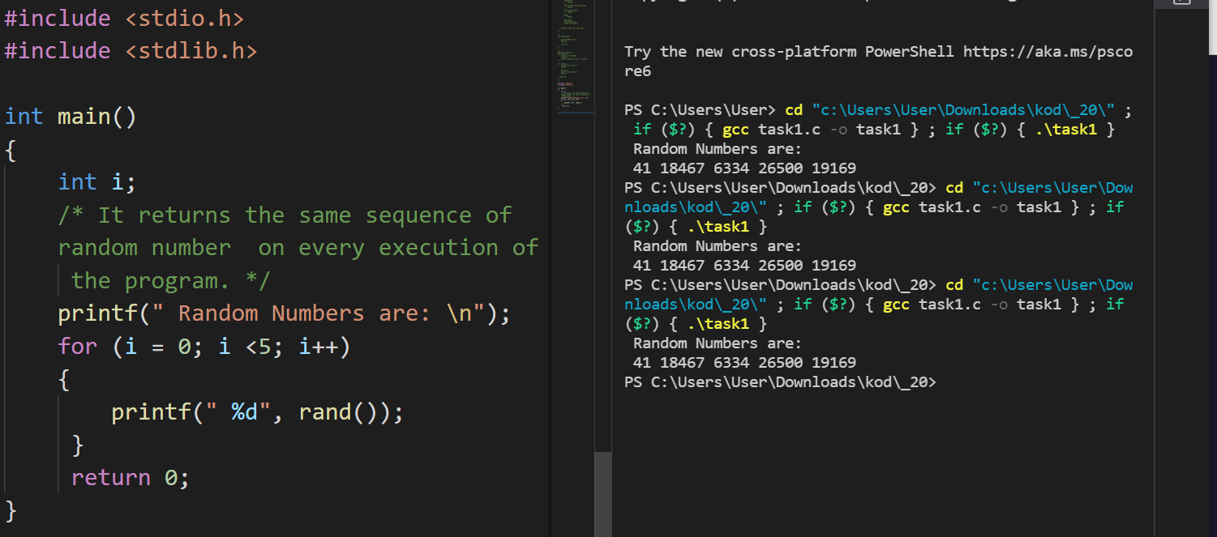
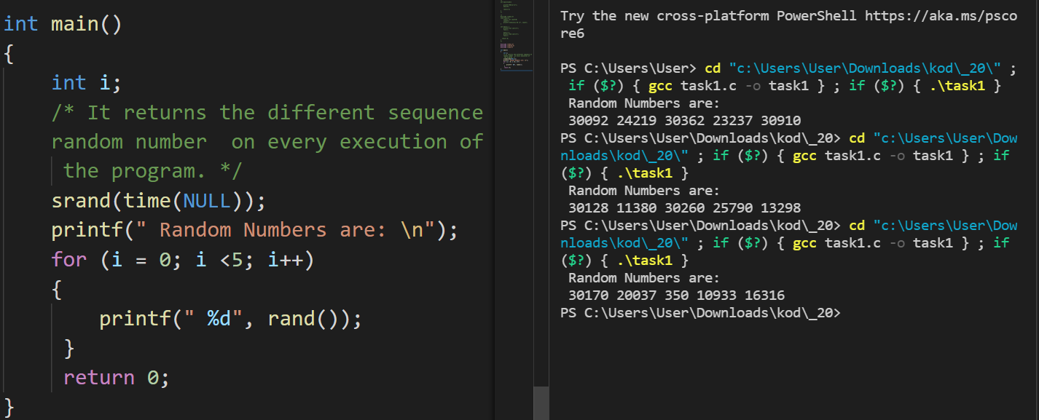
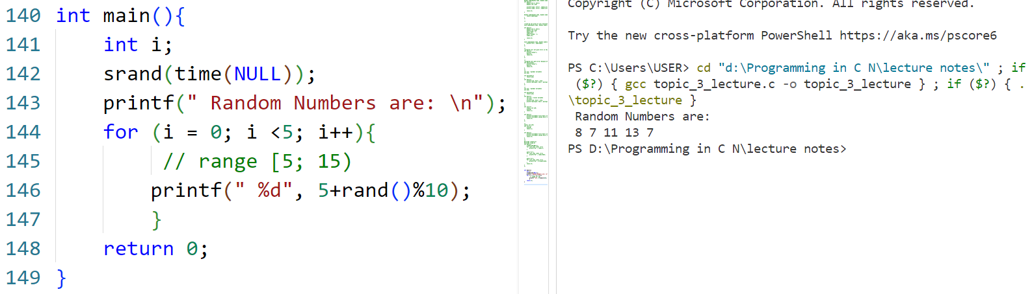
3.6 Random number generator
In the C programming language, the rand() function is a library function that generates the random number in the range [0, RAND_MAX]. When we use the rand() function in a program, we need to implement the stdlib.h header file because rand() function is defined in the stdlib header file. It does not contain any seed number. Therefore, when we execute the same program again and again, it returns the same values.
int rand (void)
The rand() function returns the random integers whose range from 0 to RAND_MAX. The RAND_MAX is a symbolic constant that defines in stdlib.h header file, whose value is greater but less than 32767 depending on the C libraries.
The srand() function is a C library function that determines the initial point to generate different series of pseudo-random numbers. A srand() function cannot be used without using a rand() function. The srand() function is required to set the value of the seed only once in a program to generate the different results of random integers before calling the rand() function.
Notes:
#include <stdio.h>
#include <stdlib.h>
int main()
{
int i;
/* It returns the same sequence of random number
on every execution of the program. */
printf(" Random Numbers are: \n");
for (i = 0; i <5; i++)
{
printf(" %d", rand());
}
return 0;
}
/*
int main()
{
int i;
srand(time(NULL));
printf(" Random Numbers are: \n");
for (i = 0; i <5; i++)
{
// range [5; 10)
printf(" %d", 5+rand()%10);
}
return 0;
}

Slide 11
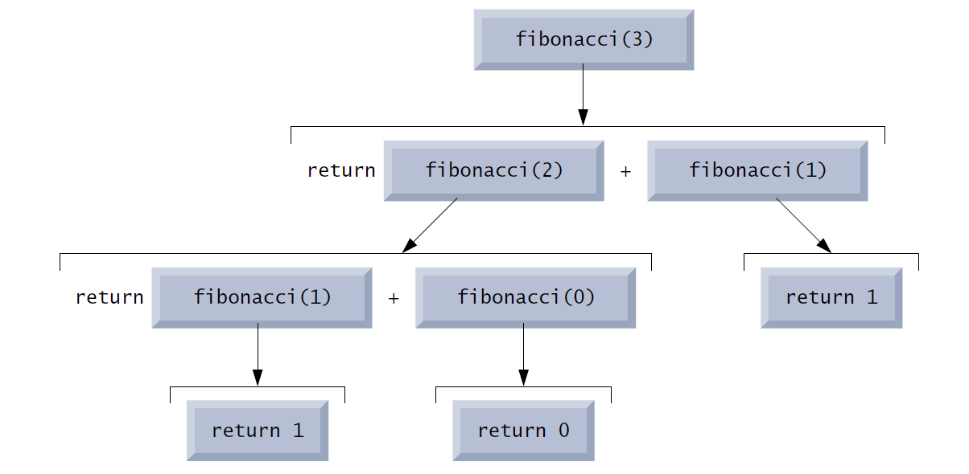
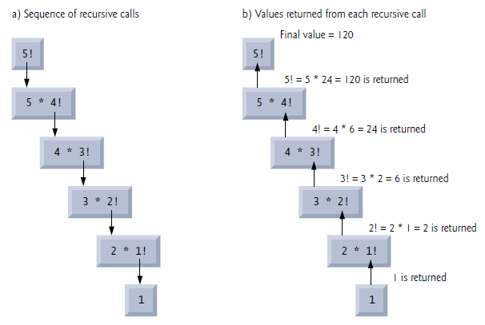
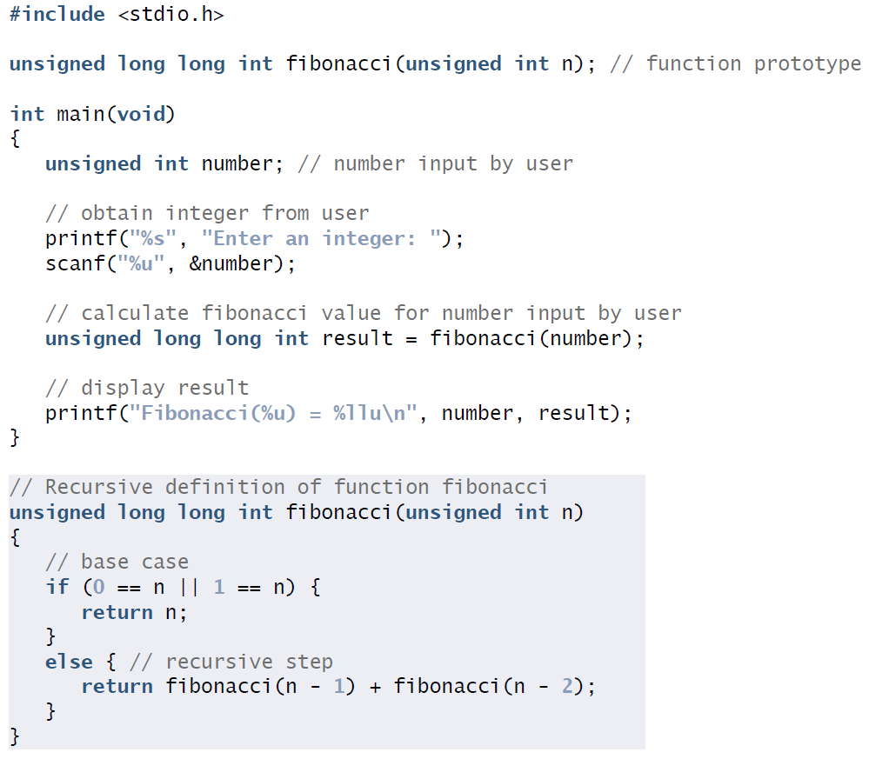
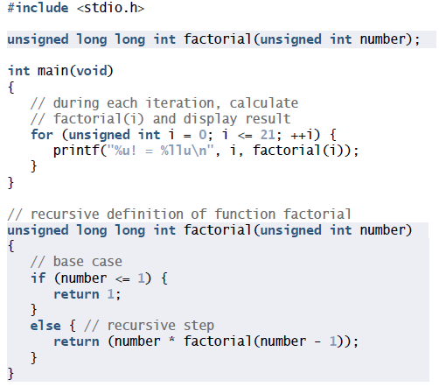
3.7 Recursion

Slide 12

References
Each Reference is indicated on the footer on each slide.
Books:
The_C_Programming_Language_(2nd_Edition_Ritchie_Kernighan)
Learn to Program with C_ Learn to Program using the Popular C Programming Language (Noel Kalicharan)
C How to Program, 8th edition, Paul Deitel and Harvey Deitel, Pearson, 2016.

Slide 13


Thank You
Nazrin Dolkhanova Sultanli
Nazrin.Sultanli.Dolkhanova@bhos.edu.az
Baku Higher Oil School

